Slide 1
重イオン衝突における粘性流体描像
門内 晶彦 （東大理）
第19回Heavy Ion Café並びに第12回Heavy Ion Pub合同研究会
「QCD物質の最前線」、2011年6月8日、名古屋大学

Slide 2
Introduction
“Standard model” of a high-energy heavy ion collision (at RHIC)
ｔ
particles
t
Freezeout
Hadronic cascade
Freezeout
QGP phase
Hydrodynamic stage
hadronic phase
Pre-equilibrium
Glasma/Thermalization
z
Color glass condensate
Relativistic hydrodynamics
Description of collective motion of the QGP (τ ~ 1-10 fm/c)
Discuss the latest experimental data at LHC and RHIC from the perspectives of viscous fluids
New Developments

Slide 3
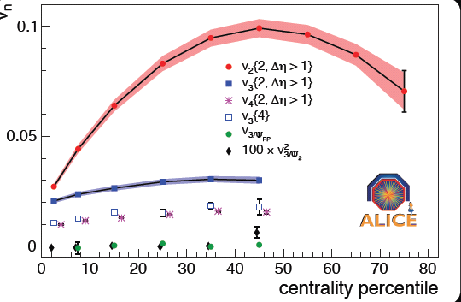
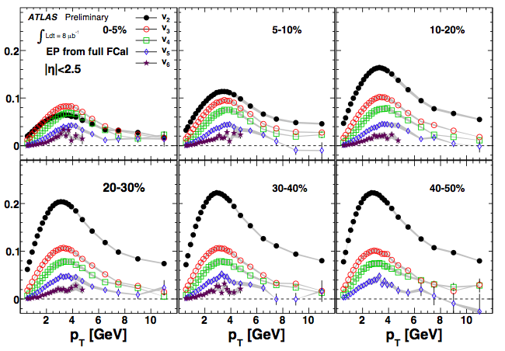
New Developments
Higher-order harmonics (v₃, v₄, v₅…)
- Quantified in hydrodynamic models
More observables = more constraints on models
- Product of initial fluctuations
ALICE plenary
ATLAS plenary
Higher-Order Harmonics

Slide 4
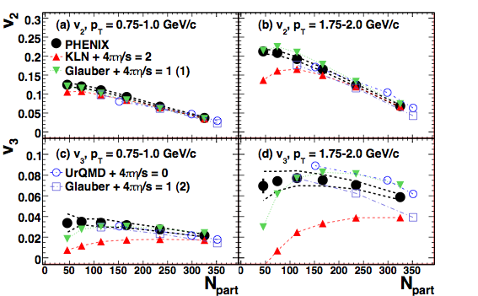
Higher-Order Harmonics
Initial conditions: Glauber (η/s = 1/4π) vs. MC-KLN (η/s = 2/4π)
PHENIX arXiv:1105.3928
v₃ in favor of Glauber?
This does not rule out the KLN
- η/s would not be indep. of temperature
- Bumpy initial conditions may mimic viscosity
- Thermalization (CGC⬄hydro)
*CGC w/o resonance decay and multiplied by factors obtained in Glauber
Higher-Order Harmonics

Slide 5
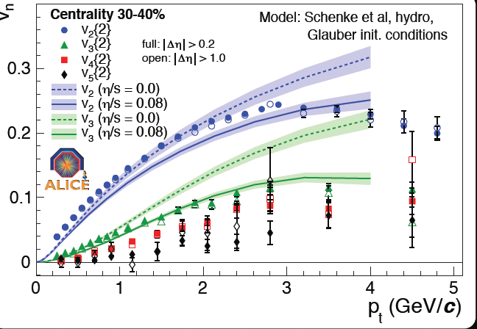
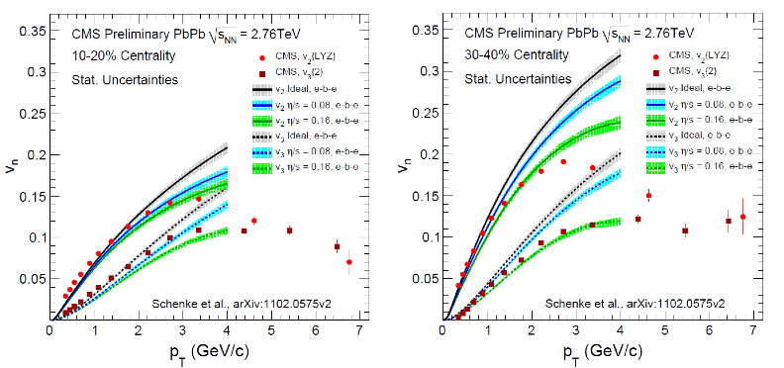
Higher-Order Harmonics
Shear viscosity: Glauber (η/s = 0) vs. Glauber (η/s = 1/4π)
ALICE (Talk by J. Schukraft)
v₃ “has different sensitivity to
η/s than v₂!”
In other words, no complete data fit by a single η/s
(at least for now)
CMS (Talk by J. Velkovska)
Bulk viscosity ζ/s ≠ 0 around T_{c} ; can become non-negligible
Higher-Order Harmonics

Slide 6
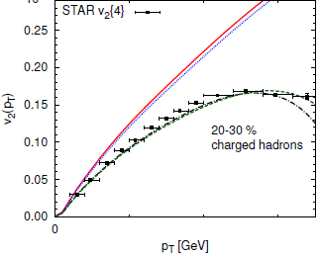
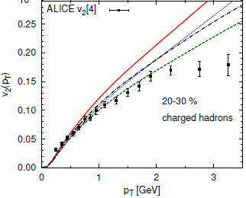
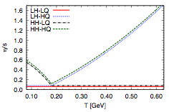
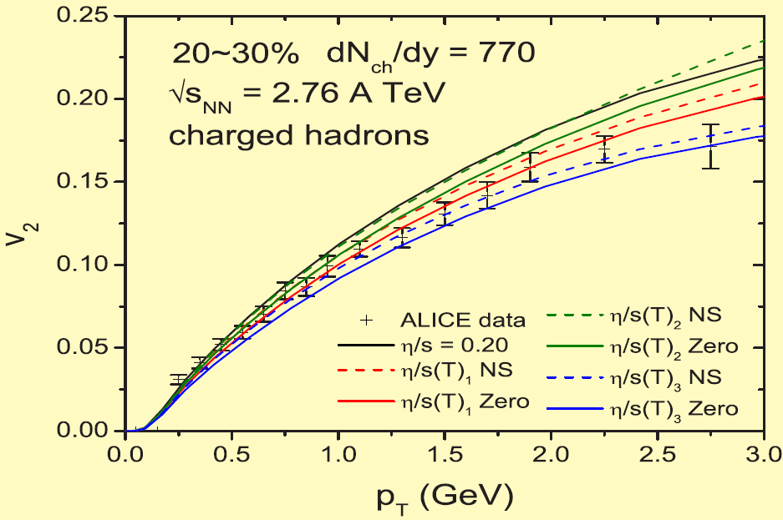
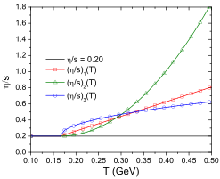
Higher-Order Harmonics
Temperature dependent η/s
Talk by H. Niemi
Hadronic viscosity always important; QGP viscosity more important at LHC than at RHIC?
Poster by C. Shen
Higher-Order Harmonics

Slide 7
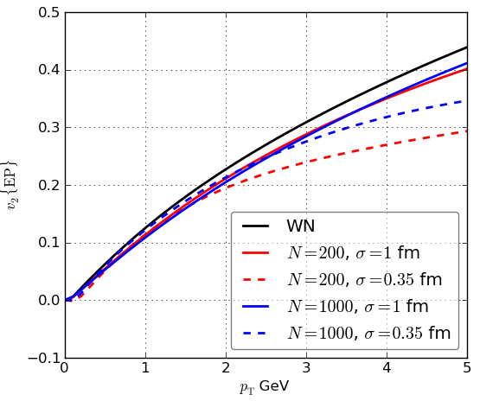
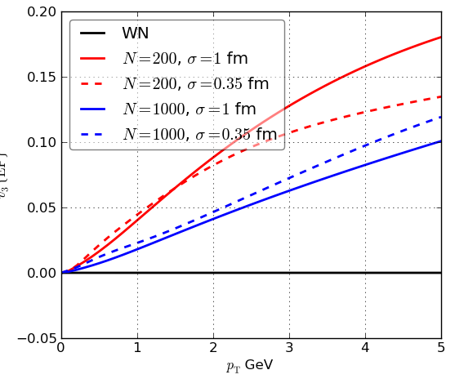
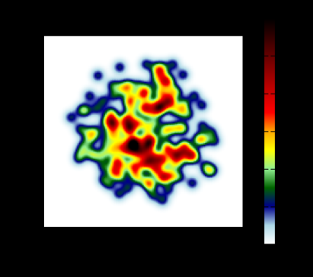
Higher-Order Harmonics
Flux tubes in initial conditions
Talk by Ph. Mota
v_{n} may depend on “bumpiness” of the initial geometry which mimics viscosity
Higher-Order Harmonics

Slide 8
Higher-Order Harmonics
More observables translate into more constraints
- Higher order harmonics in Au-Au and Pb-Pb collisions
Product of fluctuation in initial conditions; centrality independent
Possible “other” observables
- U-U collisions at RHIC for clearer intrinsic v₄?
- Intrinsic odd-order harmonics (v₃, v₅…) in asymmetric collisions
(e.g. Cu-Pb) ?
Clear centrality dependences may be observed
Towards Integrated Pictures

Slide 9
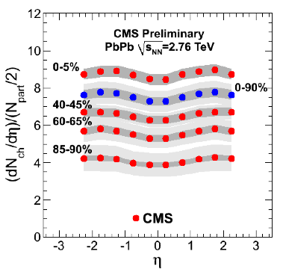
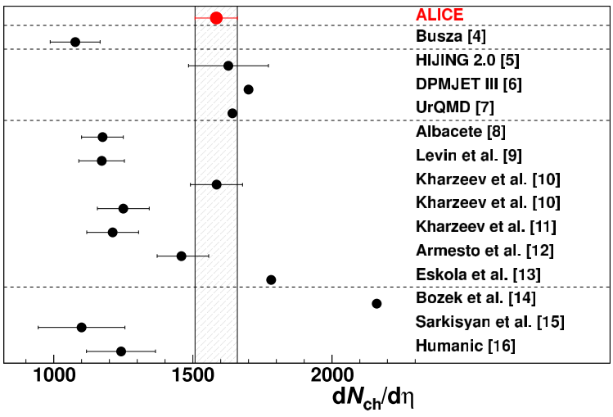
Towards Integrated Pictures
Not only transverse; Longitudinal dynamics
Pb+Pb, 2.76 TeV at η = 0
CGC
?
Charged particle multiplicity (0-5%)
CGC predictions
ALICE: dN_{ch}/dη = 1584 ± 4 ± 76
dN_{ch}/dη ~ 1200
CMS: dN_{ch}/dη = 1610 ± 55
Towards Integrated Pictures

Slide 10
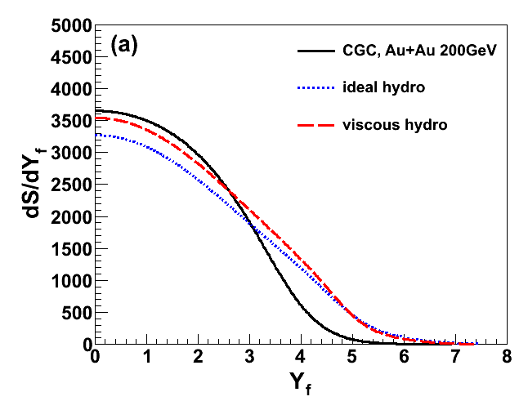
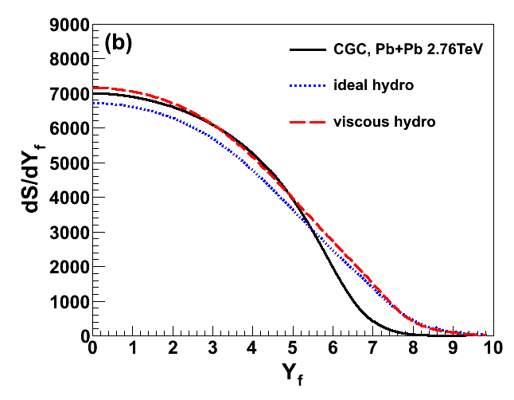
Towards Integrated Pictures
AM and T. Hirano, arXiv:1102.5053
CGC rapidity distribution + Full 2nd order viscous hydro
RHIC
LHC
Entropy production
Entropy flux
If the true λ is larger at RHIC, it enhances dN/dy at LHC;
Hydro effect is an important factor in explaining the LHC data
Currently (1+1)D; (3+1)D viscous hydro under development
Towards Integrated Pictures

Slide 11
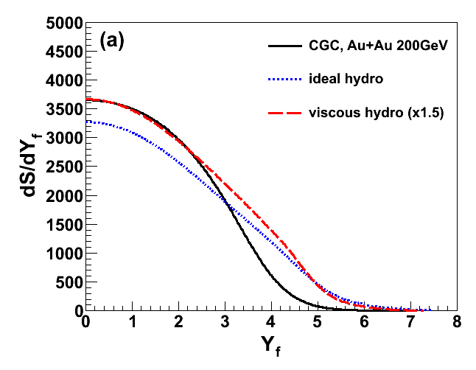
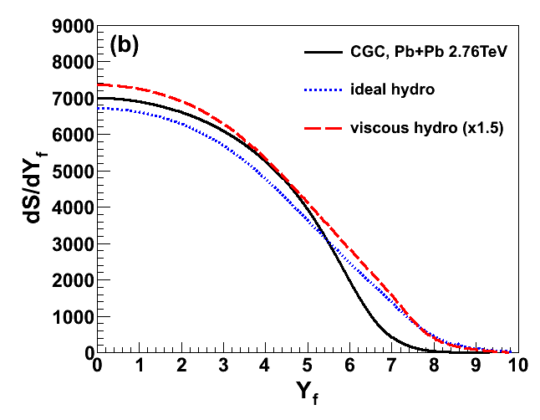
Towards Integrated Pictures
AM and T. Hirano, arXiv:1102.5053
CGC rapidity distribution + Full 2nd order viscous hydro
RHIC
LHC
Entropy production
Entropy flux
If the true λ is larger at RHIC, it enhances dN/dy at LHC;
Hydro effect is an important factor in explaining the LHC data
If the λ is unchanged at RHIC, dN/dy is still enhanced at LHC;
Hydro effect is an important factor in explaining the LHC data
Currently (1+1)D; (3+1)D viscous hydro under development
Towards Integrated Pictures

