Slide 1
高強度電磁場中の物理と
相対論的重イオン衝突への応用
服部 恒一
復旦大学 (Fudan University) → 基礎物理学研究所
Heavy-Ion Pub @ 奈良女子大、2019年1月10日

Slide 2
Table of contents
Strong magnetic fields in laboratories and nature
- Relativistic heavy ion collisions
- Neutron stars/magnetars
- High intensity laser field
Photon propagation in a magnetic field (in vacuum)
- Vacuum birefringence and (real) photon decay
- Diagrammatic techniques
Transport phenomena in a magnetic field
- Chiral anomaly-induced currents
- Condensed matters and HICs

Slide 3
Strong magnetic fields
in laboratories and nature

Slide 4
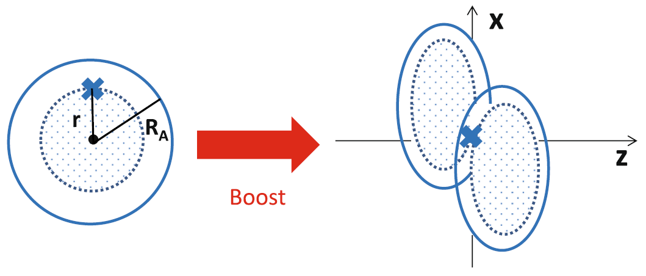
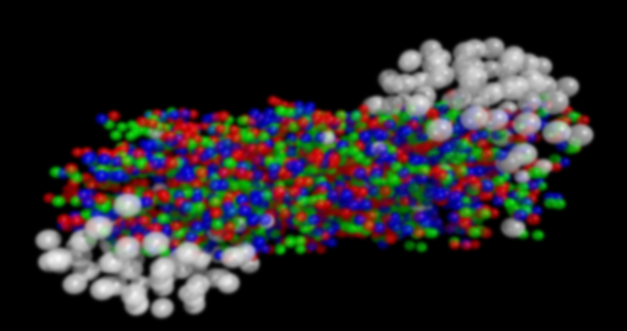
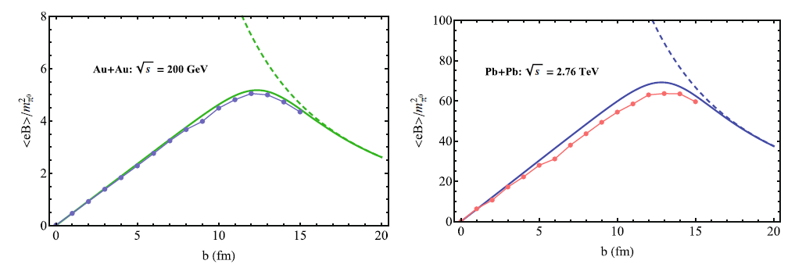
Analytic and numerical estimates of the strong B
-- Impact parameter dependences
B
Static Coulomb field → Lienard-Wiechert potential
t = 0 (at the collision)
W.-T. Deng & X.-G. Huang, KH and X.-G. Huang

Slide 5
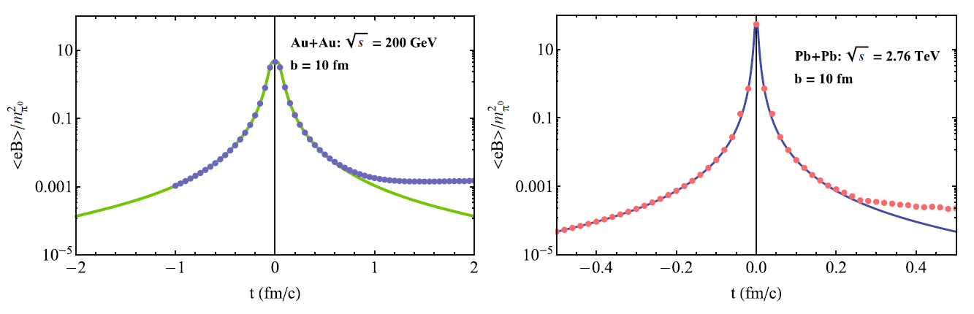
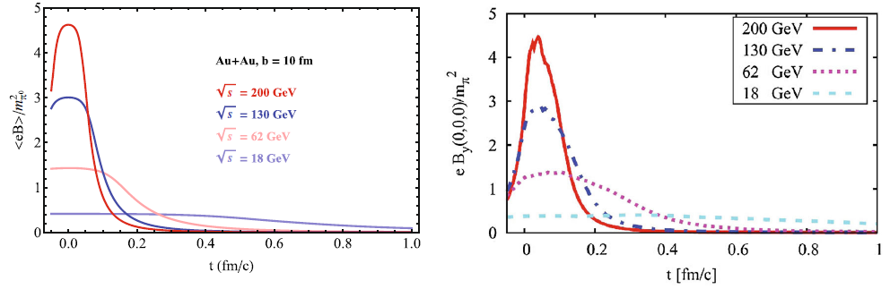
Time dependences
KH and X.-G. Huang
Collision-energy dependences
V. Voronyuk, et al. (2011)
KH and X.-G. Huang

Slide 6
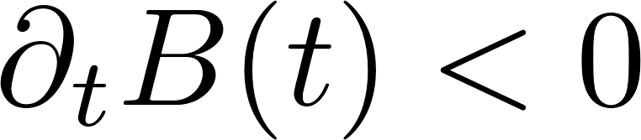
Lifetime of the B-field in HIC
B(t)
A longer lifetime due to the Lenz’s law? Tuchin
Time dependent B induces E.
E
E induces J if QGP is conducting.
→ Induced J sustains B.
Important to know the conductivity of QGP
in magnetic fields.
KH & Satow; KH, Li, Satow, Yee;
Fukushima & Hidaka
McLerran&Skokov

Slide 7
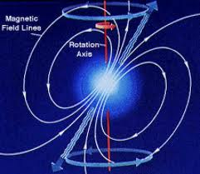
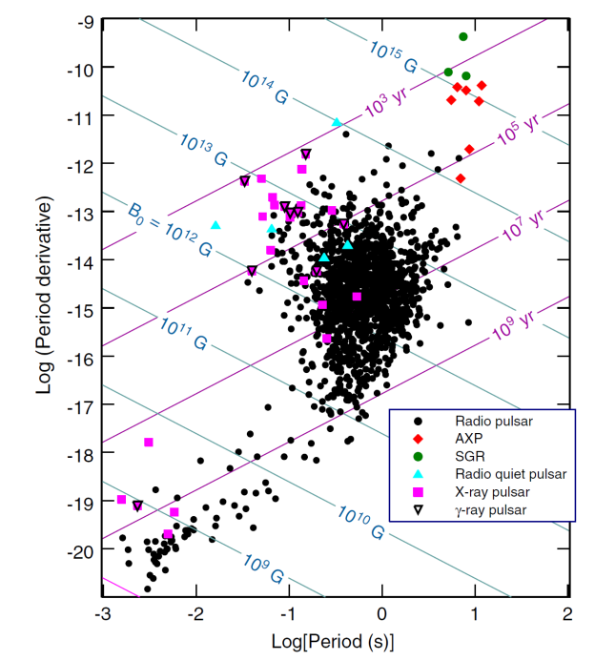
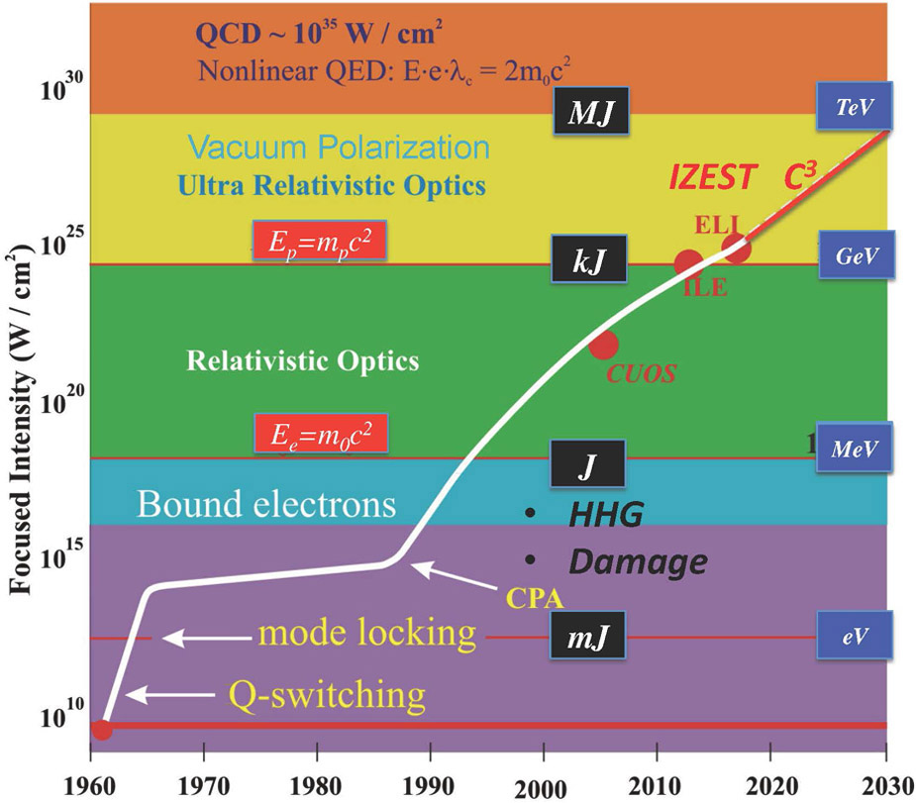
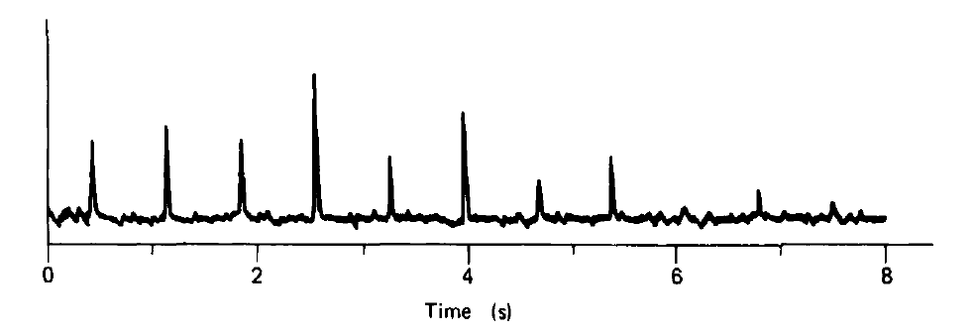
Other strong B fields
NS/Magnetar
High-intensity laser field
Magnetars
NSs
“Lighthouse” in the sky
2019
Mourou&Strickland (2018 Nobel laureates)
https://www.nobelprize.org/prizes/physics/2018/mourou/lecture/
PSR0329+54

Slide 8
Refractive index of photon in strong B-fields
- Old but unsolved problem
Coupling constant is small, unlike low-energy QCD
But,
Perturbation breaks down and resummation required
Has not been confirmed in experiments
KH and Kazunori Itakura,
“Vacuum birefringence in strong magnetic fields:
(I) Photon polarization tensor with all the Landau levels,” (2013);
(II) Complex refractive index from the lowest Landau level,” (2013).
Ishikawa, Kimura, Shigaki, Tsuji, “A numerical evaluation of vacuum polarization
tensor in constant external magnetic fields,” arXiv:1304.3655 [hep-ph].

Slide 9
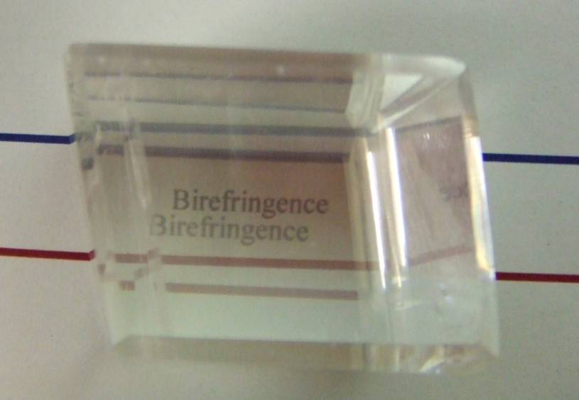
What is birefringence (複屈折)？
Response of electrons to incident lights
Structured ions
→ Anisotropic spring constants
Birefringence = Polarization-dependent refractive indices
Polarization 1
Polarization 2
Birefringent substance “Calcite” (方解石)
Lesson: The fermion spectrum is important for the photon spectrum.

Slide 10
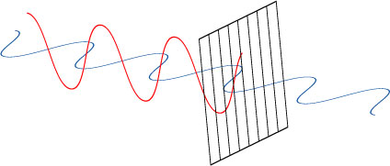
Photon propagation in magnetic fields
+ Lorentz & Gauge symmetries → n ≠ 1 in general
+ Preferred orientation due to an external B
``Vacuum birefringence (真空複屈折)”
Strong B
Polarizer

Slide 11
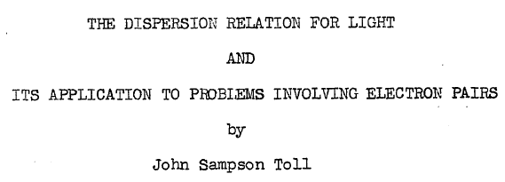
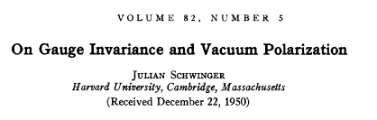
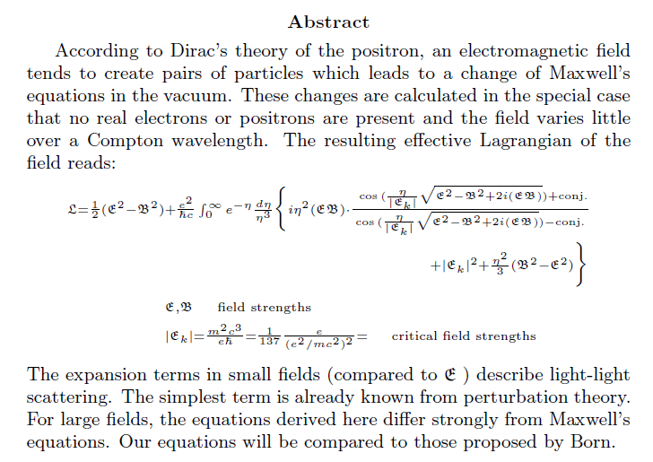
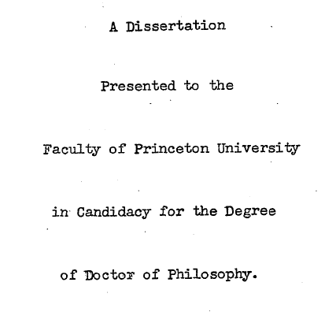
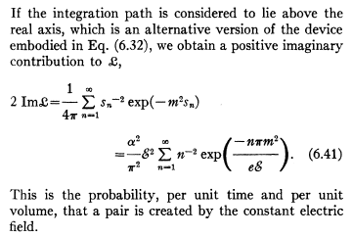
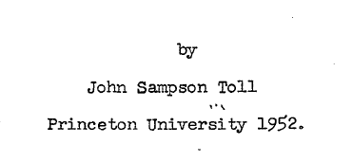
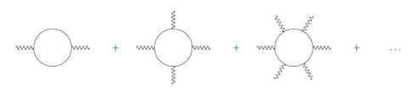
Physics of vacuum in external strong fields
Consequences of Dirac’s Theory of the Positron
W. Heisenberg and H. Euler in Leipzig1
22. December 1935
Heisenberg-Euler effective Lagrangian
- resummation wrt the number of external legs
General formula within 1-loop & constant field
obtained by the “proper-time method”.
Correct manipulation of a UV divergence in 1935!

Slide 12
Basic framework

Slide 13
Photon propagation in strong B
Modified Maxwell eq. :
Photon vacuum polarization tensor:
Dressed propagators
in Furry’s picture
Quantum effects in magnetic fields
eB
eB
eB
・・・
・・・
Large B compensates the suppression by “e”.
→ Break-down of the naïve perturbation
→ Needs a resummation

Slide 14
Proper-time method for external strong fields
Schwinger (1951)
Nonlinear wrt the external fields
eB
eB
eB
eB
+
+
・・・

Slide 15
Resumed photon self-energy

Slide 16
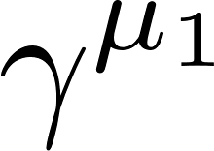
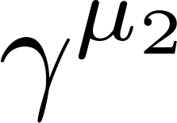
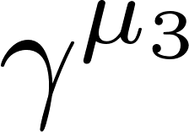
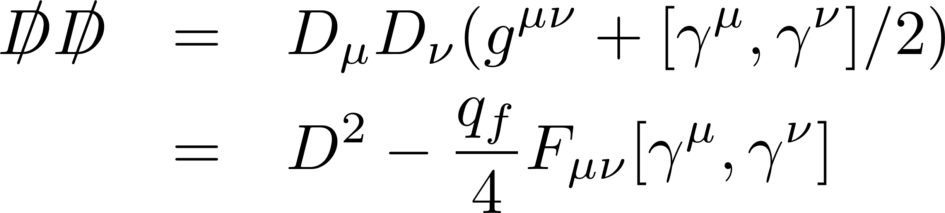
Challenges to the resumed photon self-energy
eB
eB
eB
eB
eB
eB
eB
eB
eB
eB
eB
eB
For example, one needs to perform the Dirac
trace with an “infinite” number of gamma matrices.
・・・・・・
Peskin & Schoeder tell us only tr[γ γ γ γ] or little more…
Scalar
Spin → ex) Zeeman effect in B
One needs to compute terms like
by using some techniques.
✔On the other hand, the momentum loop integral is just a Gaussian integral.

Slide 17
Resummed polarization tensor
Gauge symmetries lead to a tensor structure,
Integrands with strong oscillations
θ: angle btw B-field and
photon propagation
B
Exponentiated trig-functions generate
strongly oscillating behavior with
arbitrarily high frequency.
Schwinger, Adler, Shabad, Urrutia,
Tsai and Eber, Dittrich and Gies
Vanishing B limit:

Slide 18
Summary of relevant scales
and preceding calculations
Photon momentum
General analytic expression
?
Untouched so far
Euler-Heisenberg Lagrangian
In soft photon limit
Numerical computation
below the first threshold
(Kohri and Yamada)
Weak field & soft photon limit
(Adler)
Strong field limit: the lowest-Landau-level approximation
(Tsai and Eber, Shabad, Fukushima )

Slide 19
Decomposing exponential factors
Contains arbitrarily higher harmonics
Linear w.r.t. τ in exp.
1st step: “Partial wave decomposition”
Linear w.r.t. τ in exp.
2nd step: Getting Laguerre polynomials
Associated Laguerre polynomial
Linear w.r.t. τ in exp.

Slide 20
All of terms reduce to one of three elementary integrals.
Transverse dynamics:
Wave functions for the Landau levels given by
the associated Laguerre polynomials

Slide 21
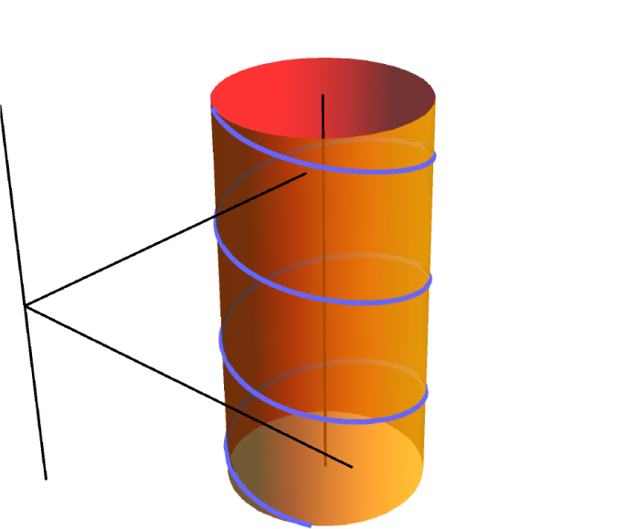
Charged-particle spectra in a magnetic field
---Landau level discretization due to the cyclotron motion
Remember a small lesson in introduction.
B
“Harmonic oscillator” in the transverse plane
Relativistic:
Nonrelativistic:
Cyclotron frequency

Slide 22
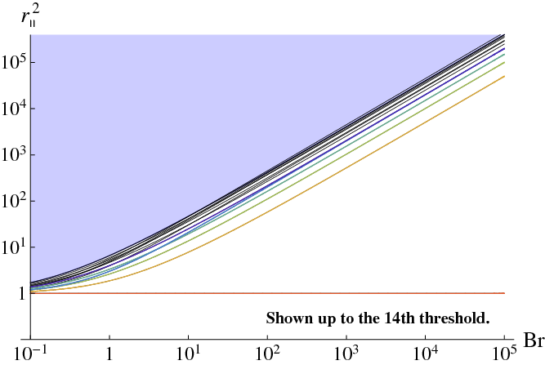
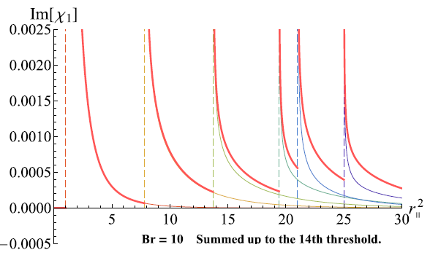
The Landau levels in the polarization tensor
Polarization tensor acquires an imaginary part when
⇔
UrHIC
Prompt photon ~ GeV²
Thermal photon ~ 300² MeV²
~ 10⁵ MeV²
Untouched so far
Narrowly spaced Landau levels
Strong field limit (LLL approx.)
(Tsai and Eber, Shabad, Fukushima )
Lowest Landau level
Soft photon & weak field limit
(Adler)
Numerical integration
(Kohri, Yamada)

Slide 23
Refractive indices and decay rate

Slide 24
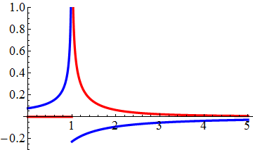
Solutions of the modified Maxwell Eq.
LLL: 1+1 dimensional fluctuation in B
B
Refractive indices at the LLL(ℓ=n=0)
Polarization excites only along the magnetic field
``Vacuum birefringence’’

Slide 25
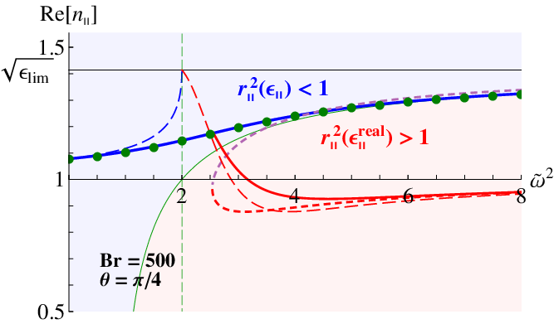
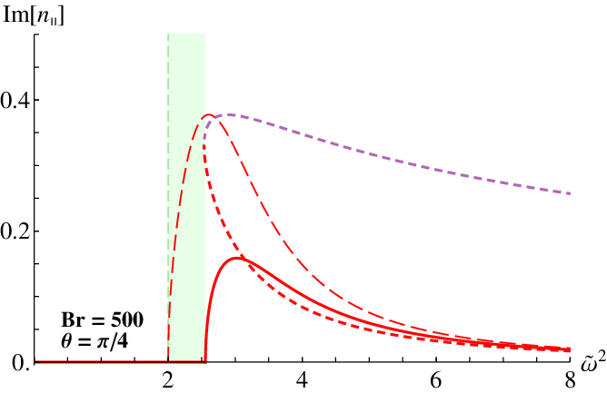

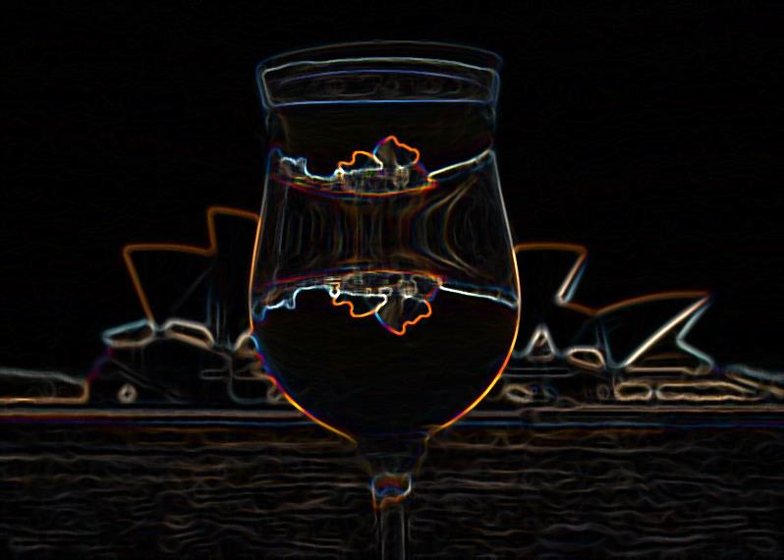


Complex refractive indices
$$ω^{2}/4m^{2}$$
≈ Magnetar << UrHIC
cf: air n = 1.0003, water n = 1.3, prism n = 1.5
$$ω^{2}/4m^{2}$$
Refraction
Image by fermion pairs

Slide 26
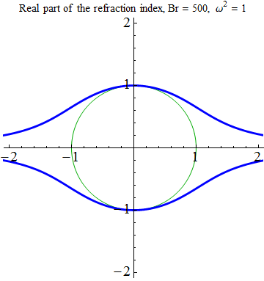
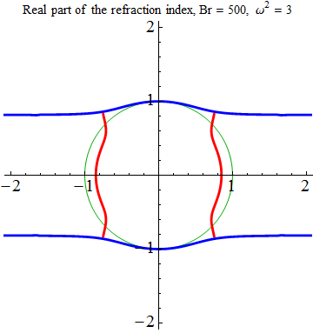
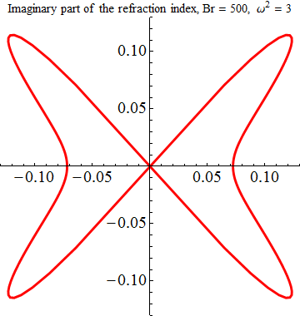
Angle dependence of the refractive index
Real part
B
Below the threshold
Above the threshold
Imaginary part
No imaginary part

Slide 27
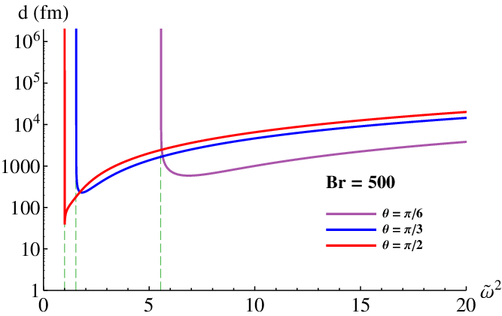
“Mean-free-path” of photons in B-fields
When the refractive index has an imaginary part,
λ (fm)
For magnetars
Smaller for a larger energy.
Same patterns for hLL.
Possible impacts on UrHIC

Slide 28
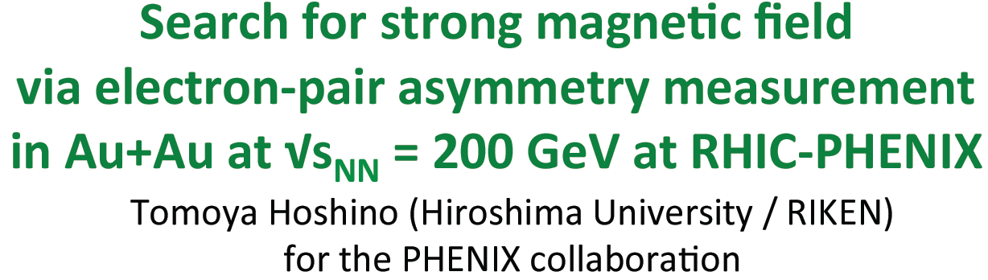
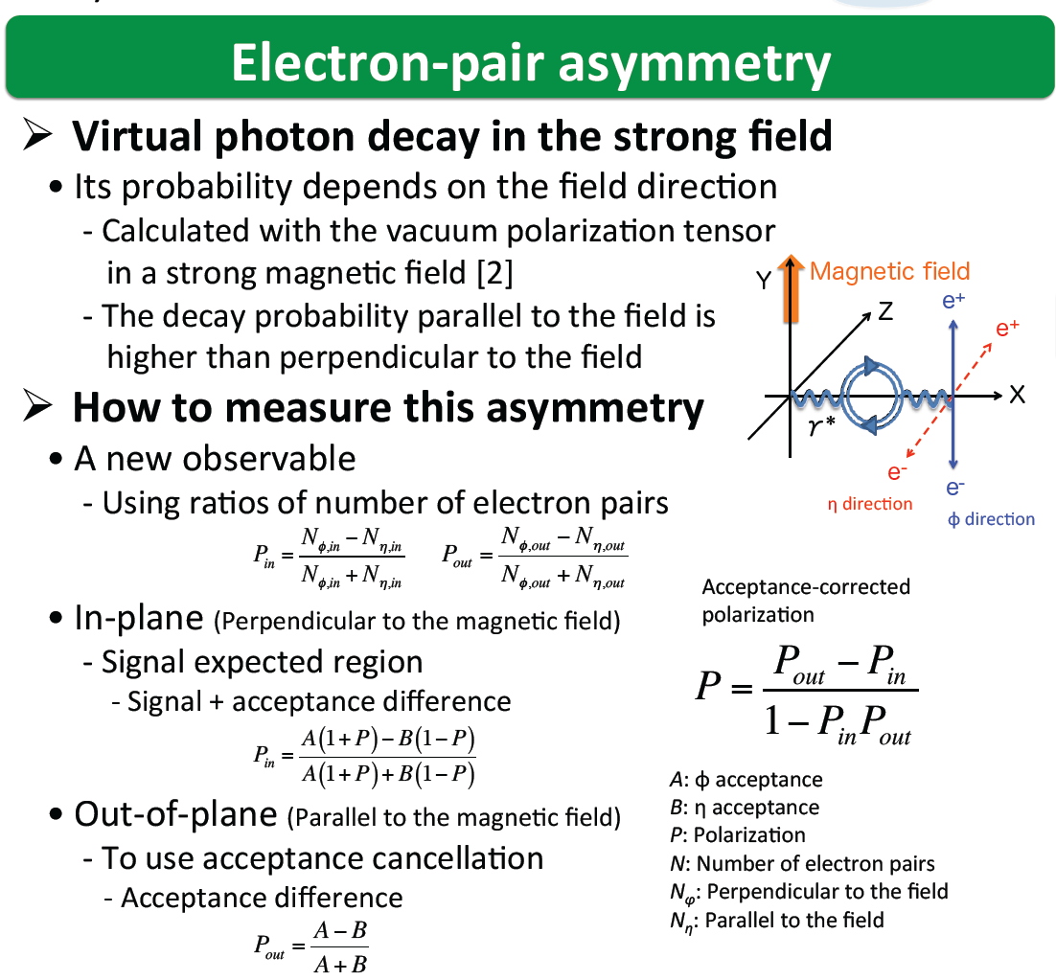
QM2014, Darmstadt

Slide 29
Transport phenomena
in strong magnetic fields

Slide 30
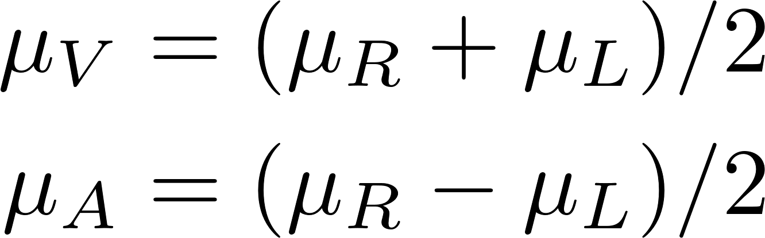
Anomaly-induced transports
in a magnetic OR vortex field
Non-dissipative transport phenomena with
time-reversal even and nonrenormalizable coefficients.
Anomaly relation:

Slide 31
Universal form of the anomalous transport coefficients
Quantum field theory
Fukushima, Kharzeev, Warringa
Chiral kinetic theory
Son & Yamamoto;
Gao, Liang, Pu, Wang, Wang;
Hidaka, Pu, Yang
Anomalous hydrodynamics
Son & Surowka;
Banerjee, Bhattacharya, Bhattacharyya, et al.;
Jensen (2012);
KH, Hirono, Yee, Yin

Slide 32
Energy levels in B – Chirality eigenstates in the lowest Landau levels
Periodic cyclotron motion
→ Landau level discretization
Zeeman splitting
“Harmonic oscillator” in the transverse plane
(If g = 2.)
The lowest Landau level = Unique ground state
Spin directions are “frozen” due to strong B.
Chirality is locked with the momentum direction.
Massless LLL states realize
chiral fermions in the (1+1) dim.
-
+

Slide 33
Landau degeneracy in the transverse plane
Distribution of equivalent cyclotron orbits
--- No (energetically) preferred position in a constant B-field
B
# of states in a unit area

Slide 34
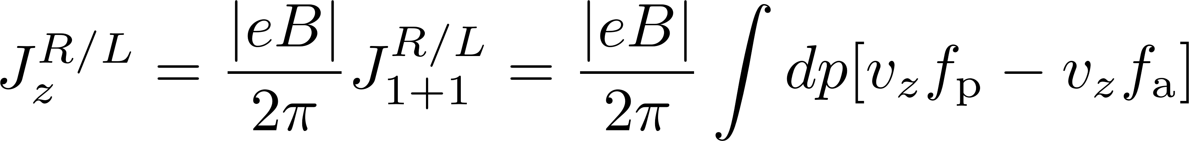
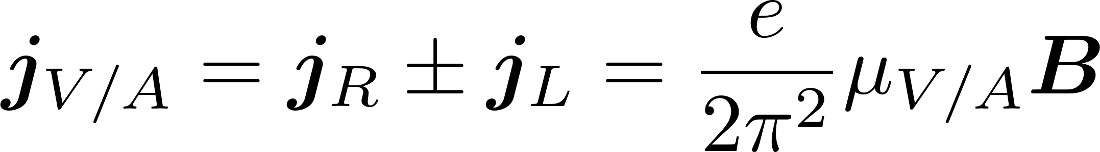
Currents in the lowest Landau level
・T dependence cancels out in the sum of particle and antiparticle contributions!
・ Higher LL contributions cancel out!
Chiral magnetic effect / Chiral separation effect

Slide 35


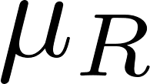

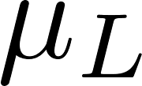

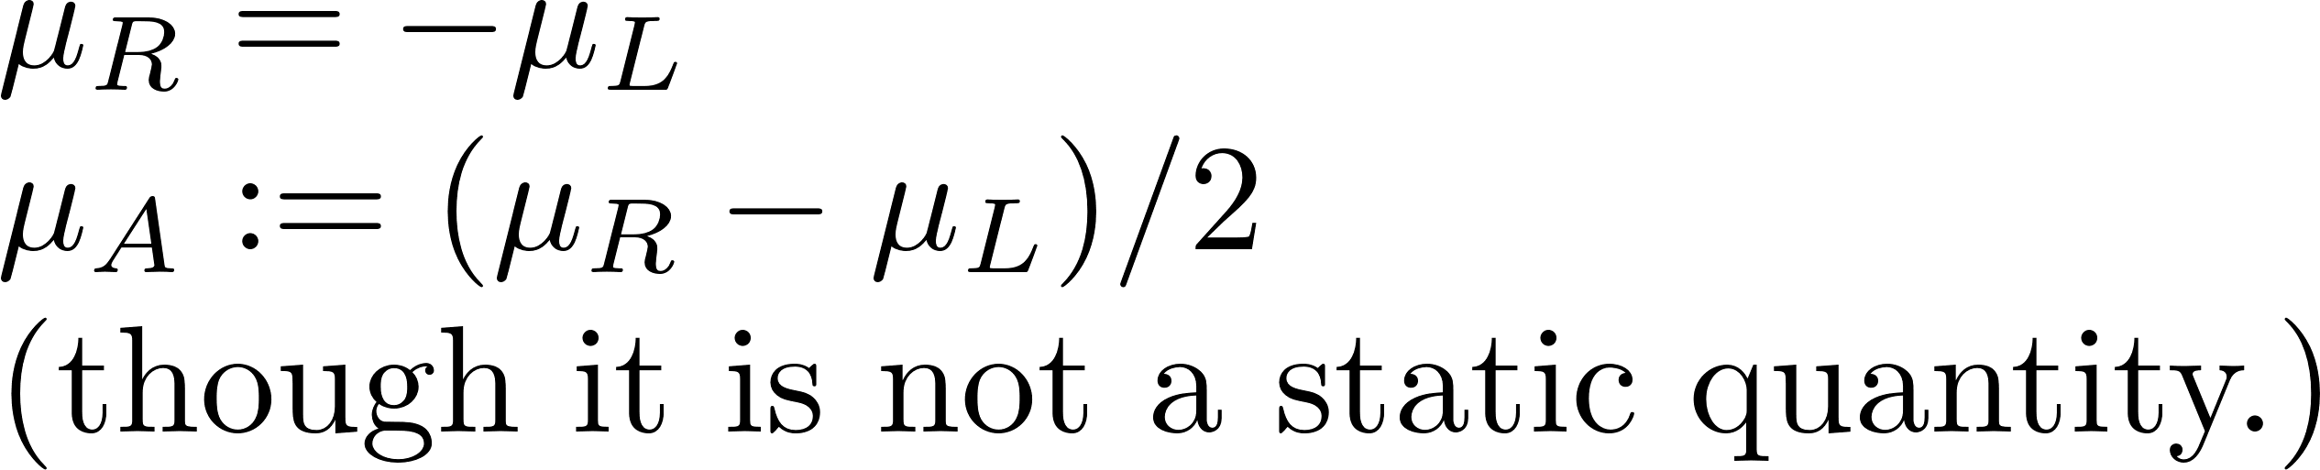
Chiral anomaly in quasi-(1+1) dimensions
--- when a parallel electric field (E//B) is applied
Acceleration by E
Creation/annihilation near the surface
of bottomless Dirac sea.

Slide 36


Bottom of the sea
--- UV-finite (lattice) models
“Loop” in the bottom
Nielsen, Ninomiya (1983)
“The lesson is that in the lattice theory we do not necessarily have the right
to ignore the bottom of the Dirac sea.” Ambjorn, Greensite, Peterson (1983)

Slide 37
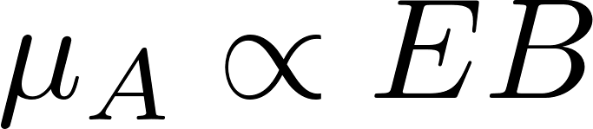
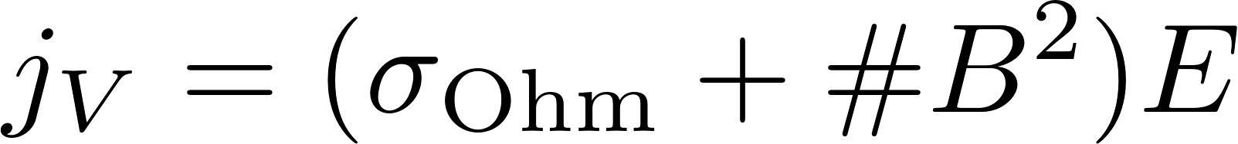


Anomalous transport in condensed matter systems
When parallel electric and magnetic fields are applied ,
Son & Spivak;
Li, Kharzeev, et al.
from the “chiral anomaly.”
“Negative magnetoresistance”
Borrowed from Li and Kharzeev
Li, Kharzeev, et al.

Slide 38
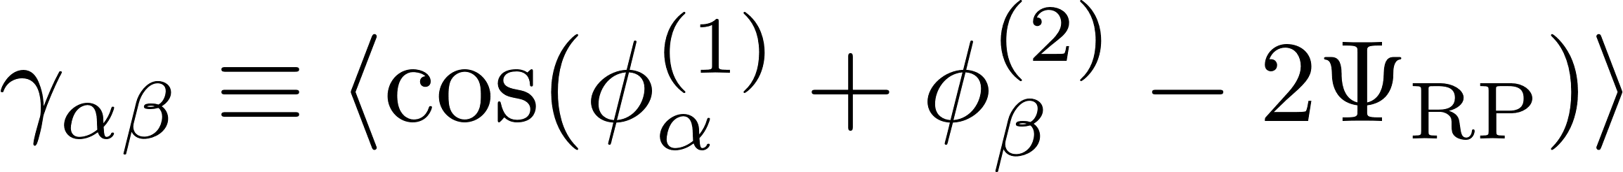
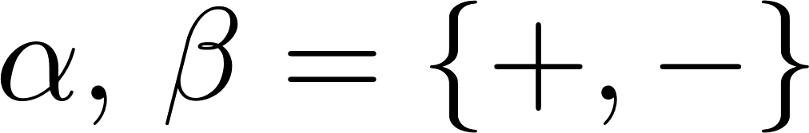
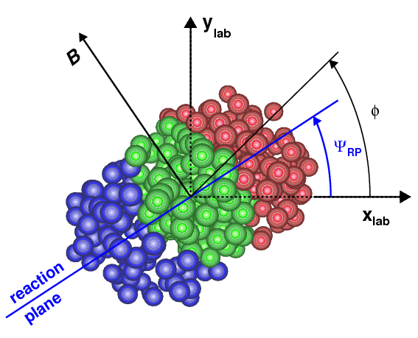
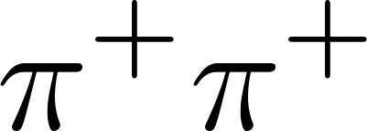
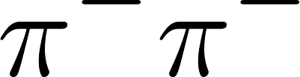
Chiral magnetic effect search in heavy-ion collisions
PRL103
PRL118
Understanding and subtracting backgrounds are challenging issues
in the current experimental status.

Slide 39
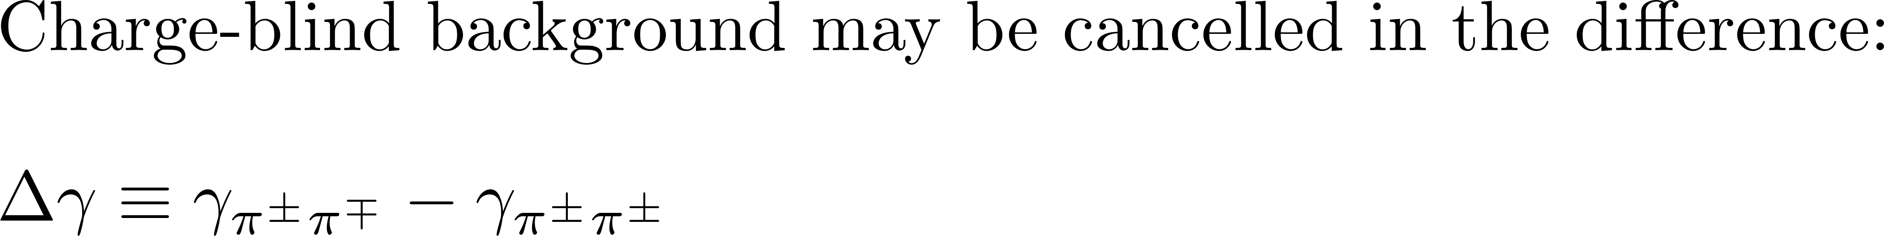






Controlling possible backgrounds
Δγ
Yet, if a local charge conservation is imposed,
unlike-sign pairs are more likely to be detected
in a small relative angle, because of the flow.
This effect is charge-dependent and contaminates Δγ.
+ -
- +
+ -
- +
Can isobaric collisions help us to
extract the magnetic-field effects?
Cf., Deng, Huang, Ma, Wang for for recent estimates
What can we really learn beyond the current (theoretical) status
if the CME is measured in HIC? Do we understand just backgrounds?

Slide 40
What talked today
in review articles
Coming soon…
Landau-level quantization
Resummation techniques
Applications
Phenomenologies
More review papers in the ref. lists

Slide 43
The earliest work: Euler-Heisenberg Lagrangian
- Low-energy (soft photon) effective theory
Quantum corrections in magnetic fields
eB
eB
eB
eB
+ Constant magnetic fields
・・・
+ Should be suppressed in
the ordinary perturbation theory,
but not in strong B-fields.
・・・
Poincare invariants
Vacuum birefringence
(Refractive indices n≠1)
Photon splitting
eB
eB
Soft photon limit

Slide 44


Renormalization
=
+
+
+
・・・
Log divergence
Term-by-term subtraction
Finite
Ishikawa, Kimura, Shigaki, Tsuji (2013)
Re
Im
Taken from Ishikawa, et al. (2013)

Slide 45
Dispersion relation from the resummation
The strong field limit revisited:
Lowest Landau level (LLL) approximation (n=0)
Spin-projection operator
Wave function
1+1 dimensional
dispersion relation
1+1 dimensional fluctuation

Slide 46


Neutron stars = Pulsars
What is the mechanism of radiation?
→ Possibly “QED cascade” in strong B-fields
“Photon Splitting”
Softening of photons
< pm
Cyclotron spectrum is observed
in ordinary NSs,
but not in magnetars.

Slide 47


What else?
--- Chiral symmetry and its spontaneous breaking
Fukushima, Hatsuda

Slide 48


Endrodi, JHEP07(2015)
T = 0
Magnetic catalysis
of the χSB
BCS instability (Cooper pairing)
The SSB occurs for the dimensional reason, and thus irrespective of strengths of coupling constants. (χSB occurs even in weak-coupling QED.)

